Slide 1
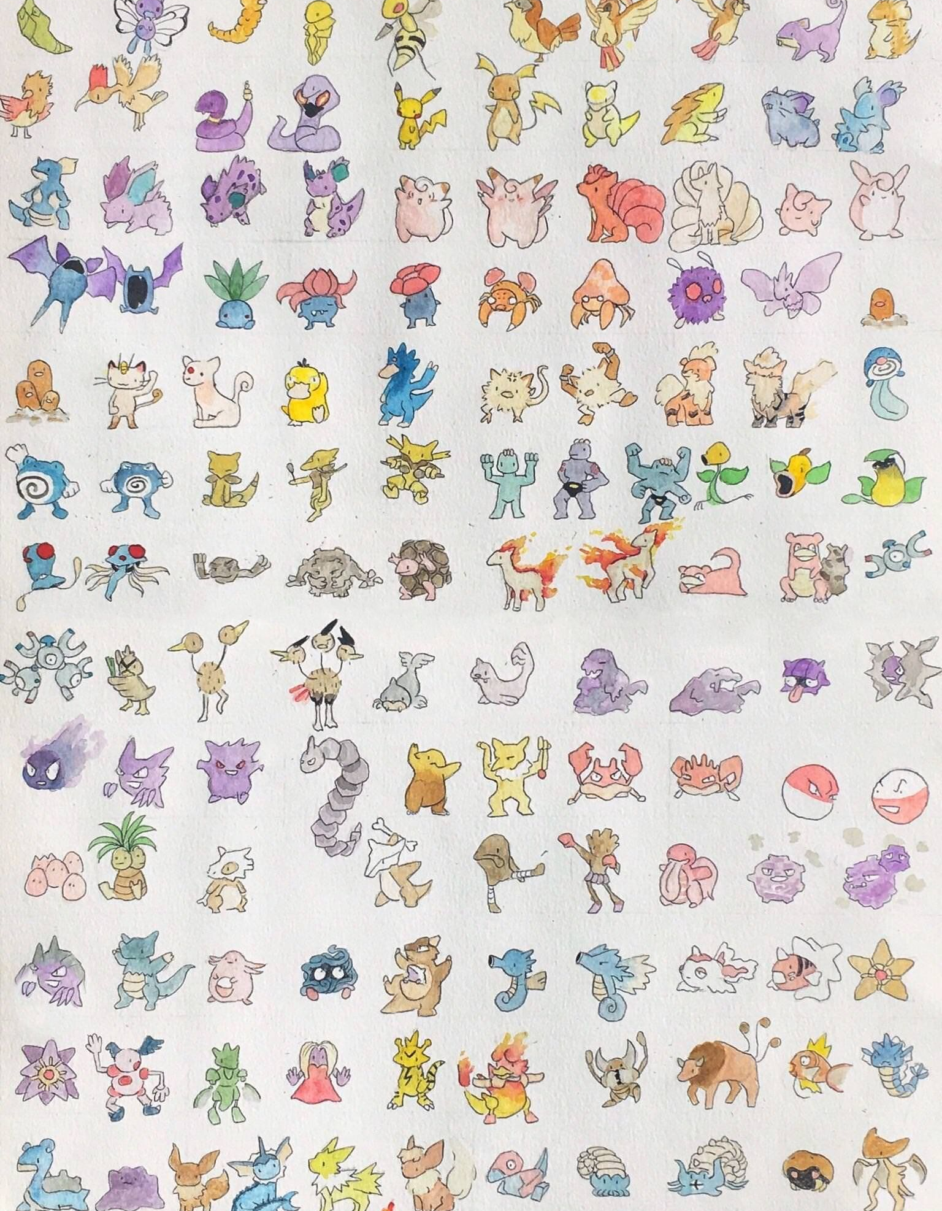
Generation 1 Pokédex
By: Baljot Hansi & Chris Rafinski​

Slide 2

Agenda
1
2
3
4
5
Motivation
Objective
Live Demo
Limitations
Future Scopes

Slide 3
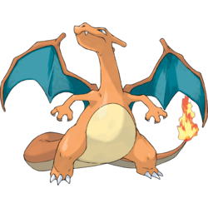
Motivation
Mutual passion for Pokémon
Bountiful ideas on how to develop the app

Slide 4

Objectives

Slide 5
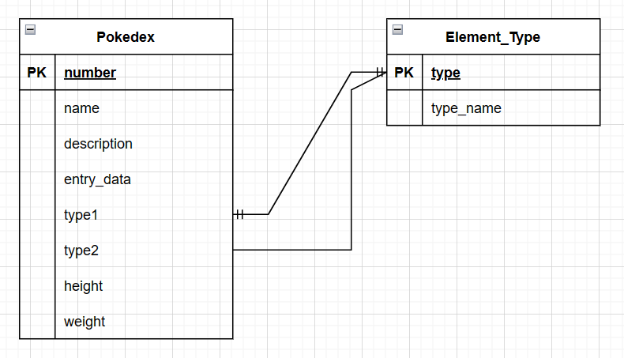
Back End
Database design

Slide 6
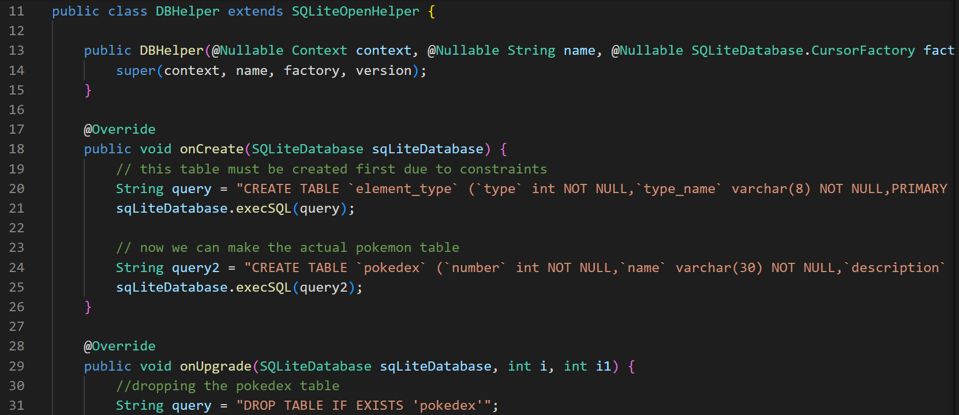
Back End
Data retrieved from https://bulbapedia.bulbagarden.net/wiki/Main_Page
Made in MySQL initially, changed to SQLite for ease and compatibility

Slide 7


Limitations
Time
We’re students with other courses
Man-Power
Two-man team limited us to generation 1 Pokémon

Slide 8



Future Scopes​
More Pokémon
Animations
Sound
Include more generations, ideally all of them. ​
Include transitions between views and activities, and other animations during the use of the app.
Include sound bits of Pokémon cries, game music, and sound effects for clicks and transitions.

Slide 9

Thank you
Any questions?

